Slide 1
Korean Baseball
Pitching
Team Win-Loss Percentage and ERA Predictions
Group- 16

Slide 2
Table of contents
01
Introduction
02
Problem statement
03
Methodology
04
Conclusion

Slide 3

KBO League
top professional baseball league in South Korea and is one of the most popular sports leagues in the country. It has a large and growing fan base and is a major source of revenue for the teams and the league itself.

Slide 4
01
Introduction
Why ?

Slide 5
Business Understanding
The KBO League, established in 1982, has captivated the hearts of South Koreans, becoming an integral part of the nation's sporting landscape. With its ever-expanding fan base and growing financial clout, the KBO League serves as a vital economic engine, generating substantial revenue for both teams and the league itself.

Slide 6
Dataset
'id', 'year', 'team', 'average_age', 'runs_per_game', 'wins', 'losses',
'win_loss_percentage', 'ERA', 'run_average_9', 'games', ‘complete_game', 'shutouts', 'saves', 'innings_pitched', 'hits', 'runs', 'earned_runs', 'home_runs', 'walks', 'strikeouts', 'hit_batter', 'balks','wild_pitches', 'batters_faced', 'WHIP', 'hits_9', 'homeruns_9', 'walks_9', 'strikeouts_9', 'strikeout_walk', 'team_number'
Shape of initial data
(323, 32)
Shape of data after EDA
(323, 9)
'wins', 'losses', 'games', 'saves', 'runs_per_game', 'innings_pitched', 'earned_runs', 'win_loss_percentage', 'ERA'

Slide 7


Formula to calculate

Slide 8
02
Problem statement
What?

Slide 9
“Current methods for predicting KBO League pitching teams' win-loss percentage and ERA (Earned Run Average) are often inaccurate and unreliable, limiting teams' ability to make informed decisions and optimize performance.

Slide 10
Potential Impacts
Pitching
Team Management
Team pitch performance can reveal the future performance and challenges.
From the coach perspective reviewing the teams pitching performance and can make adjustments

Slide 11
03
Methodology
How?

Slide 12
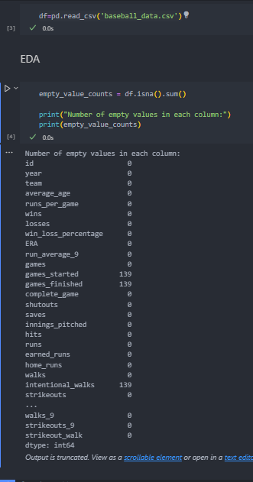
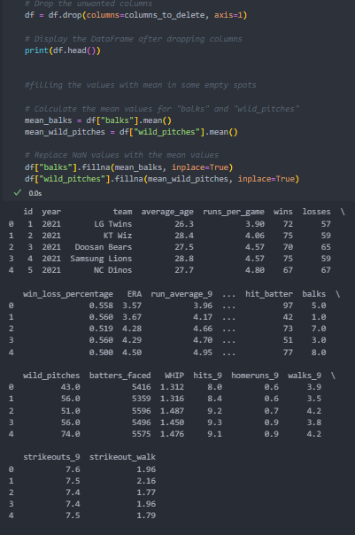
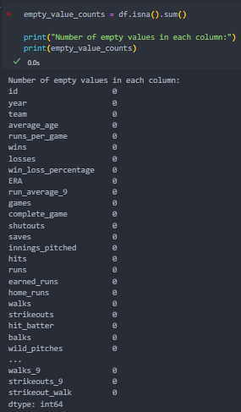

Slide 13
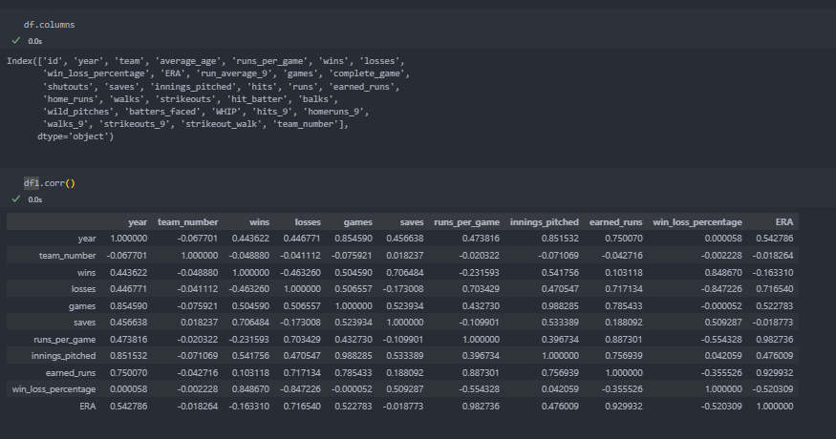

Slide 14
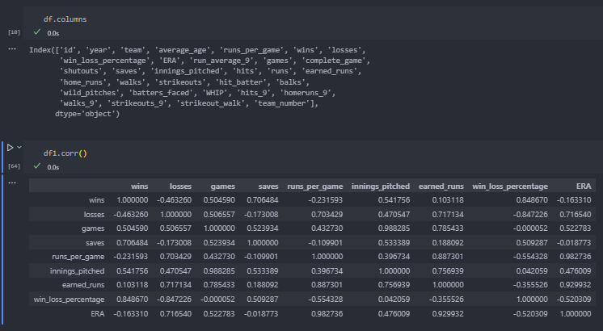

Slide 15
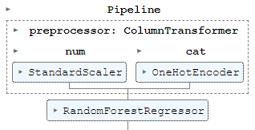

Slide 16
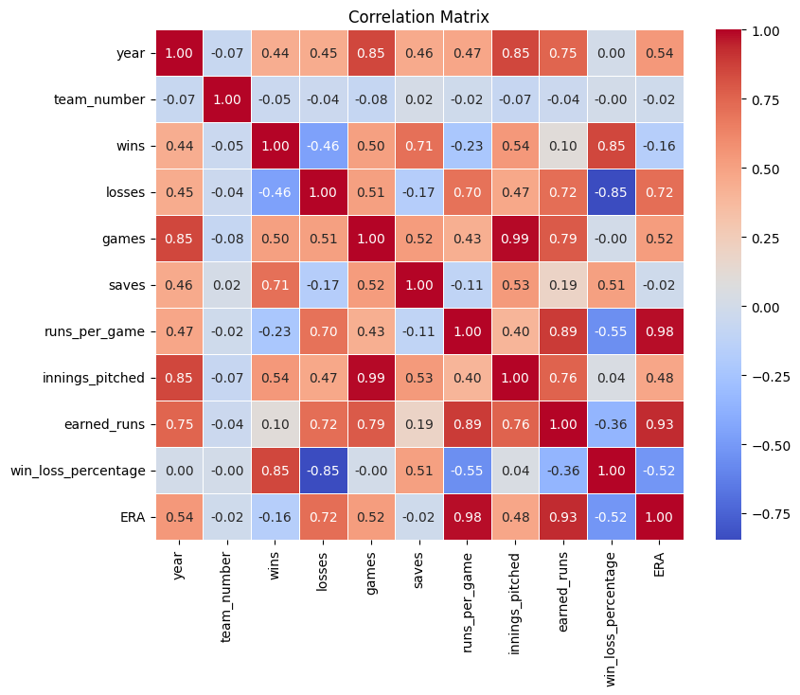
Correlation matrix of features

Slide 17
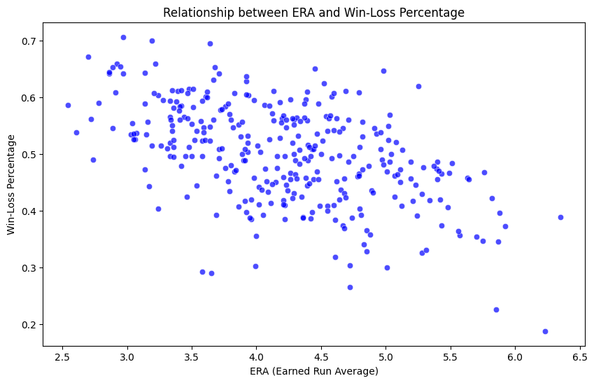
Notes:
Models

Slide 18
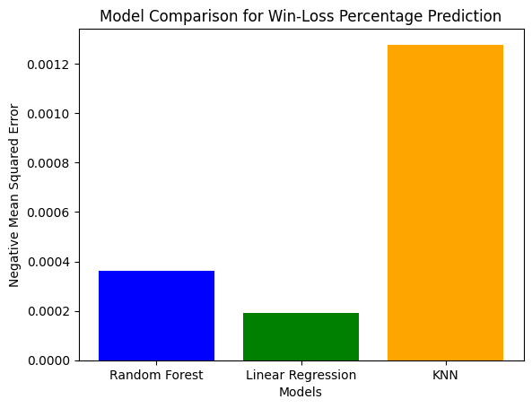
Models
KNN
Random Forest
Linear Regression
Notes:
Models

Slide 19
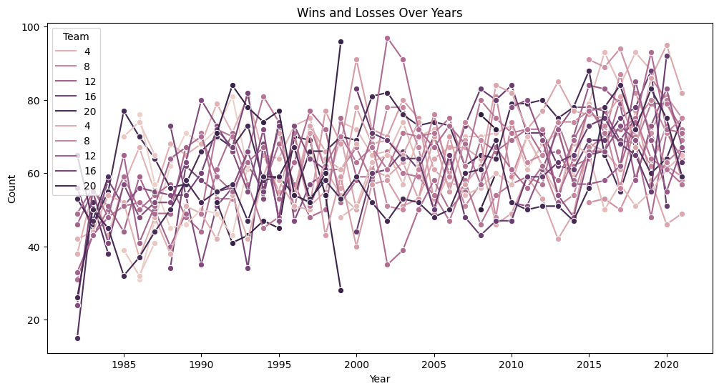
Notes:
Models

Slide 20
Result of MSE in Prediction of Win-loss percentage
 | Linear Regression | Random Forest
Cross validation Score (Negative means square | 0.00019 | 0.00036
Mean square error | 0.00013 | 0.00023
Notes:
Models

Slide 21
Result of MSE in Prediction of ERA
 | Linear Regression | Random Forest
Cross validation Score (Negative means square ) | 0.00019 | 0.00036
Mean square error | 0.04519 | 0.0151
Notes:
Models

Slide 22
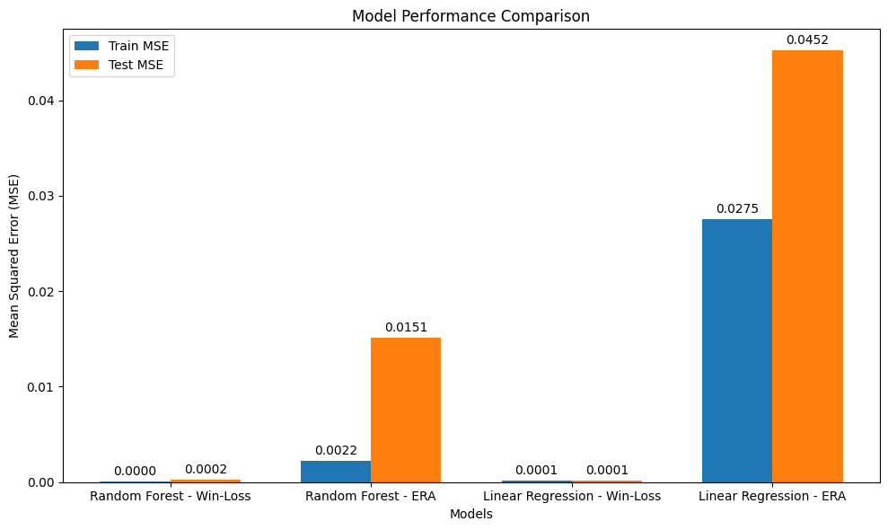

Slide 23
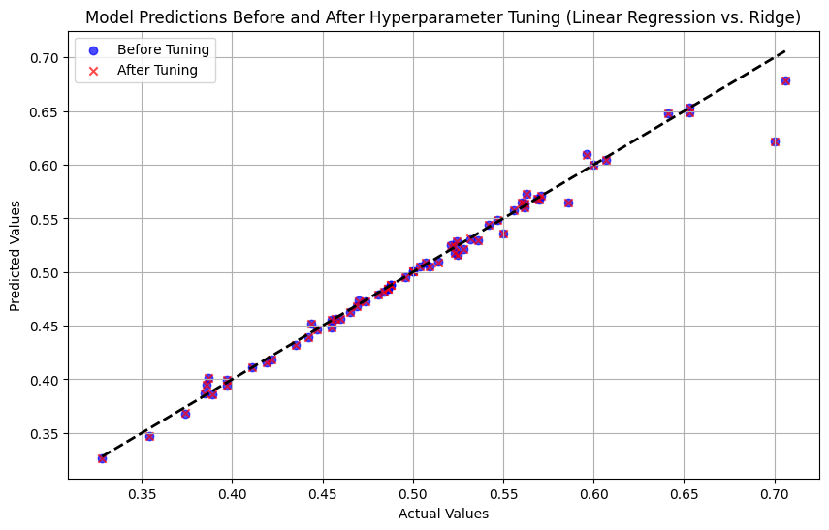

Slide 24
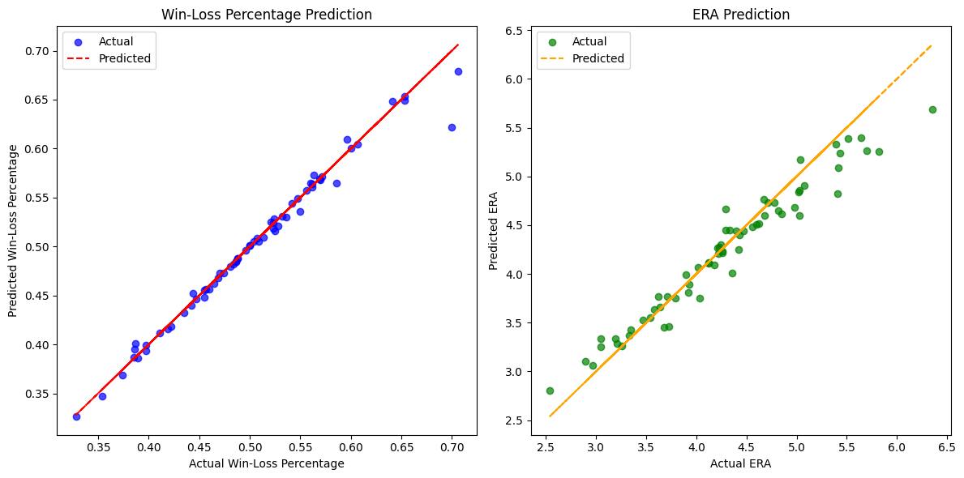
The result of prediction

Slide 25
04
Conclusion

Slide 26
In conclusion we build two different models to predict the win-loss percentage and ERA of the pitching teams of the KBO.
Because of the small data set,the models work efficiently and MSE results are small enough to evaluate that our prediction is quite accurate.
We need more business understanding to use some of the features to build complex models and get better results.
Because of the small data source we have limitation in feature selection and engineering.
To predict the better team win-loss percentage we need batting and fielding team.
We can also build complex deep learning models like CNN and ANN to obtain the better results for win-loss percentage and ERA.

Slide 27


67.202.12.16:8080
Github link-https://github.com/minsetaung1995/CP-project-.git

Slide 28
Thank you
Any Questions?
Team members (Group 16)
Albin Raj Maskey (st123469), Min Set Aung (st122825)

